Slide 1


NEWS AGGREGATOR
USING DJANGO FRAMEWORK
CAPSTONE PROJECT SHOWCASE
Student Name :
ANKIT SHARAN
Student ID :
College Name :
STU659949545af3c1704544596
KIIT-DU

Slide 2
CAPSTONE PROJECT SHOWCASE
Project Title
NEWS AGGREGATOR USING DJANGO FRAMEWORK
Abstract | Problem Statement | Project Overview | Proposed Solution | Technology Used | Modelling & Results | Conclusion | Q&A

Slide 3
Abstract
1
What is a news aggregator?
2
Benefits of using a news aggregator (e.g., saves time, personalized content, diverse perspectives)
3
Introduction of Django framework (benefits for building news aggregator)
4
Overview of the presentation

Slide 4


Problem Statement
Information overload in the digital age
Difficulty in keeping up with diverse news sources
Time inefficiencies in browsing multiple news websites
Lack of a personalized news experience

Slide 5

Project Overview
Objective: Develop a user-friendly web application for news aggregation
Target audience: Anyone interested in staying informed about current events
Functionality overview:
Ability to search for news by keyword or topic
Display of headlines and short snippets from various sources
Option to navigate to the original source for full articles
Potential for personalization features (future development)

Slide 6
Proposed Solution
Django Framework: Benefits for building web applications (rapid development, security, scalability)
Model-View-Template (MVT) architecture: Data organization and presentation separation
Data fetching using web scraping or APIs (ethical considerations for scraping)
User interface (UI) design for intuitive navigation and information display

Slide 7
Technology used
Programming Language: Python (benefits for readability, large developer community)
Web Framework: Django (discussed in previous slide)
Web Scraping Libraries: Beautiful Soup4, soupsieve,sqlparse,tzdata,urllib3,idna,
gunicorn,packaging,requests,bs4,asgiref,certify,charset-normalizer
Database: SQLite3 for storing data
HTML, CSS, Javascript ,Bootstrap and Images : Building the user interface and dynamic functionalities.

Slide 8
Modelling & Result
from django.db import models
# Create your models here.
class Headline(models.Model):
title = models.CharField(max_length=200)
image = models.URLField(null=True, blank=True)
url = models.TextField()
def __str__(self):
return self.title

Slide 9
Modelling & Result
News Source:
This model will store information about the news websites your aggregator gathers content from.
Attributes might include:
name: Onion News
url: https://www.theonion.com/
image logo url (optional): https://i.kinja-img.com/image/upload/c_fit,q_60,w_1315/e433d4b002417c789c203505f471a382.jpg

Slide 10
Modelling & Result
This model will store information about individual news articles collected from various sources.
Attributes could include:
title: The headline of the news article.
url: The complete URL of the article on the source website.
image logo url: The URL of the image stored in host website.
source: A link to the News Source model it belongs to.
category: A category for the article (e.g., "Politics", "Technology", "Sports").

Slide 11
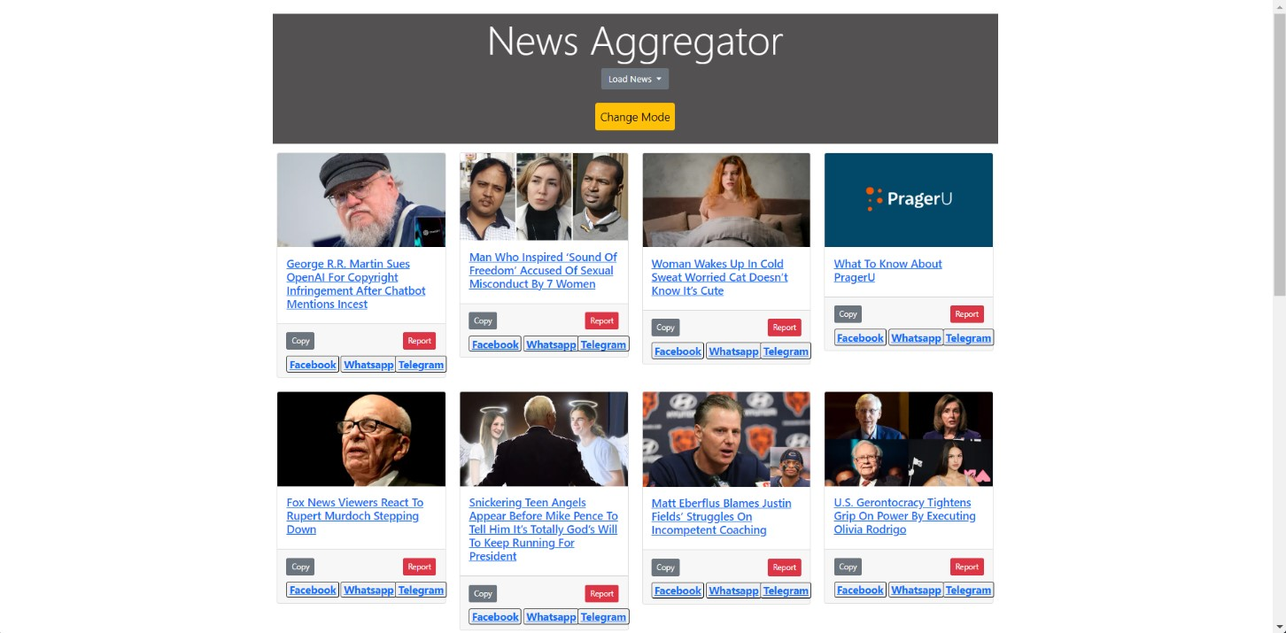
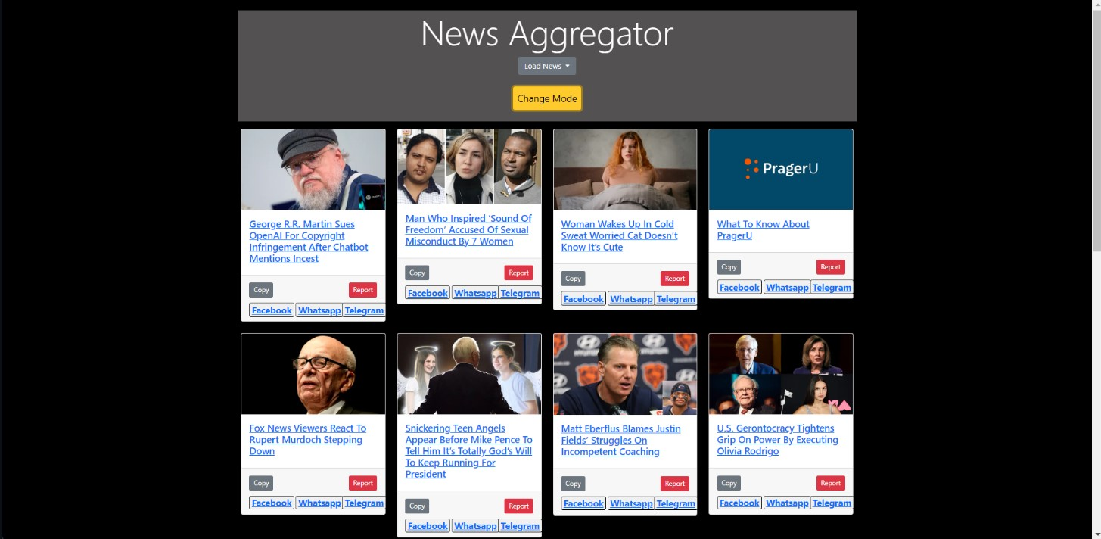
Modelling & Result
SCREENSHOTS:-

Slide 12

Conclusion
In conclusion, the development of a news aggregator using the Django framework has been a valuable experience that has resulted in a functional and efficient platform for aggregating and presenting news content. Through the implementation of Django's powerful features such as ORM for database management, templating for frontend design, and authentication for user management, we were able to create a robust application that meets the core requirements of a news aggregator. Ultimately, using Django to build a news aggregator has been a gratifying project that demonstrates the framework's ability to create scalable and dynamic online applications. The news aggregator has the potential to become a go-to resource for consumers looking for well chosen and current news content from a variety of sources with ongoing updates and improvements.

Slide 13


Notes:
Thank You !!

